Slide 1
Phishing Campaign
“The Conference Registration Phishing Attempt”
Group 25- Dasaray Fyall, Hayden Free, Nataly Garcia

Slide 2
Phishing Campaign Overview
Campaign explanation
We (the attackers) figured that a spear phishing campaign would be the best approach for this assignment.
Spear phishing was chosen because we are using personal details to target a specific person. In this specific case, the Michael D. Brown was identified as the target.
After conducting a search of personal information, we realized that the individual was an experienced cybersecurity professional that values professional development such as obtaining additional certification and attending conferences.
With this in mind, we believed that creating an email with information from an actual conference requesting the individual to sign up to attend the conference would be a great approach for the phishing email.

Slide 3
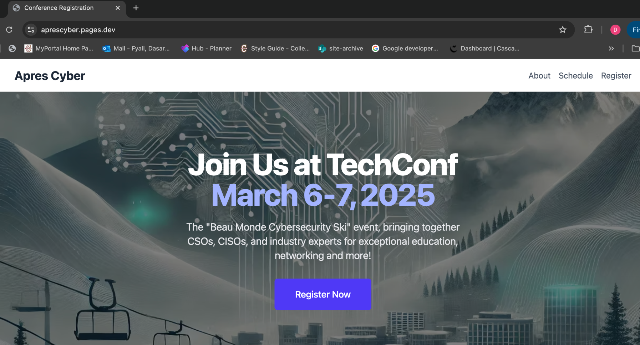
Goal and Purpose
Goal-to obtain the TA's personal information such as login credentials and financial data such as credit card numbers during the registration process.
Purpose- to convince the TA to enter their personal information onto the fake registration form for an actual conference. With this information, we (the attackers) can attempt to use this information to get access to other platforms that probably use the same credentials. We can also use the financial information to submit fraudulent charges.

Slide 4
Exploitation and Damages
Personal and financial data that is obtained through this phishing attempt can be sold on the dark web. The attackers can also use the information to pose as the TA and attempt to take information from other faculty members and students after gaining their trust.
Monetary damage: Attackers can commit identity theft or conduct fraudulent charges with the credit card information that was submitted by the TA.
Operational: If the target enters their professional credentials, it allows the attacker to gain access to academic systems and records to conduct further activities.

Slide 5
Reconnaissance Plan
Specifies target:
The target is Michael D Brown who is considered as a Teaching Assistant (TA) at Georgia Tech. He is also an experienced cybersecurity professional that worked in many organizations such as Presidio and Fortinet.
Gather information about Michael Brown from several sources such as:
the TA professional social media network (i.e. Linkedin)
several blogs (blog 1, blog 2, blog 3)
obtaining email addresses from college directory
Identifying conferences that the TA may be interested in attending by conducting a search through different conferences' websites.

Slide 6
Reconnaissance Plan cont.
Target Environment:
Since the phishing email is sent to the TA's email, the TA would most likely complete the registration form with their professional credentials. The email system (Microsoft Outlook) is set as a single sign on authentication which allows a person to gain access to several applications in Buzzport.
Vulnerabilities
the corrupted email will be sent to the TA's work email through Microsoft Outlook and it can be seen on whatever device that the TA uses (such as laptop or mobile phone). Since it's a part of Microsoft Outlook, the event will be saved on the calendar if accepted. This will allow the attacker to get access into the network and take control of the target's device.
Possible Failure Points and/or Target Defenses:
Since the target is an experienced cybersecurity professional, the TA might recognize the phishing attempt.
The email may not reach the professor if the university firewall or the spam filter blocks it.
MFA could prevent the attacker from gaining full access to the accounts.

Slide 7
The Exploit
Command-and-Control (C2) Node & Backend:
Most phishing campaigns, scripts are used to attack a wide range of potential victims (C2 node). If a person clicks on any corrupted links, then the data is stored on the attacker's servers (backend).
In our case, the fake conference registration page is hosted on our server and we used Microsoft Outlook to send the corrupted email to a specific target (C2). If the TA submits their information, the TA's data will be saved in our database (backend).
The Delivery Platform:
The phishing attack will consist of a conference invite that is sent to the TA's email which is hosted in Microsoft Outlook that was provided by Georgia Tech. Within that email, a link to a registration form will be included as our method to obtain personal and financial information.

Slide 8
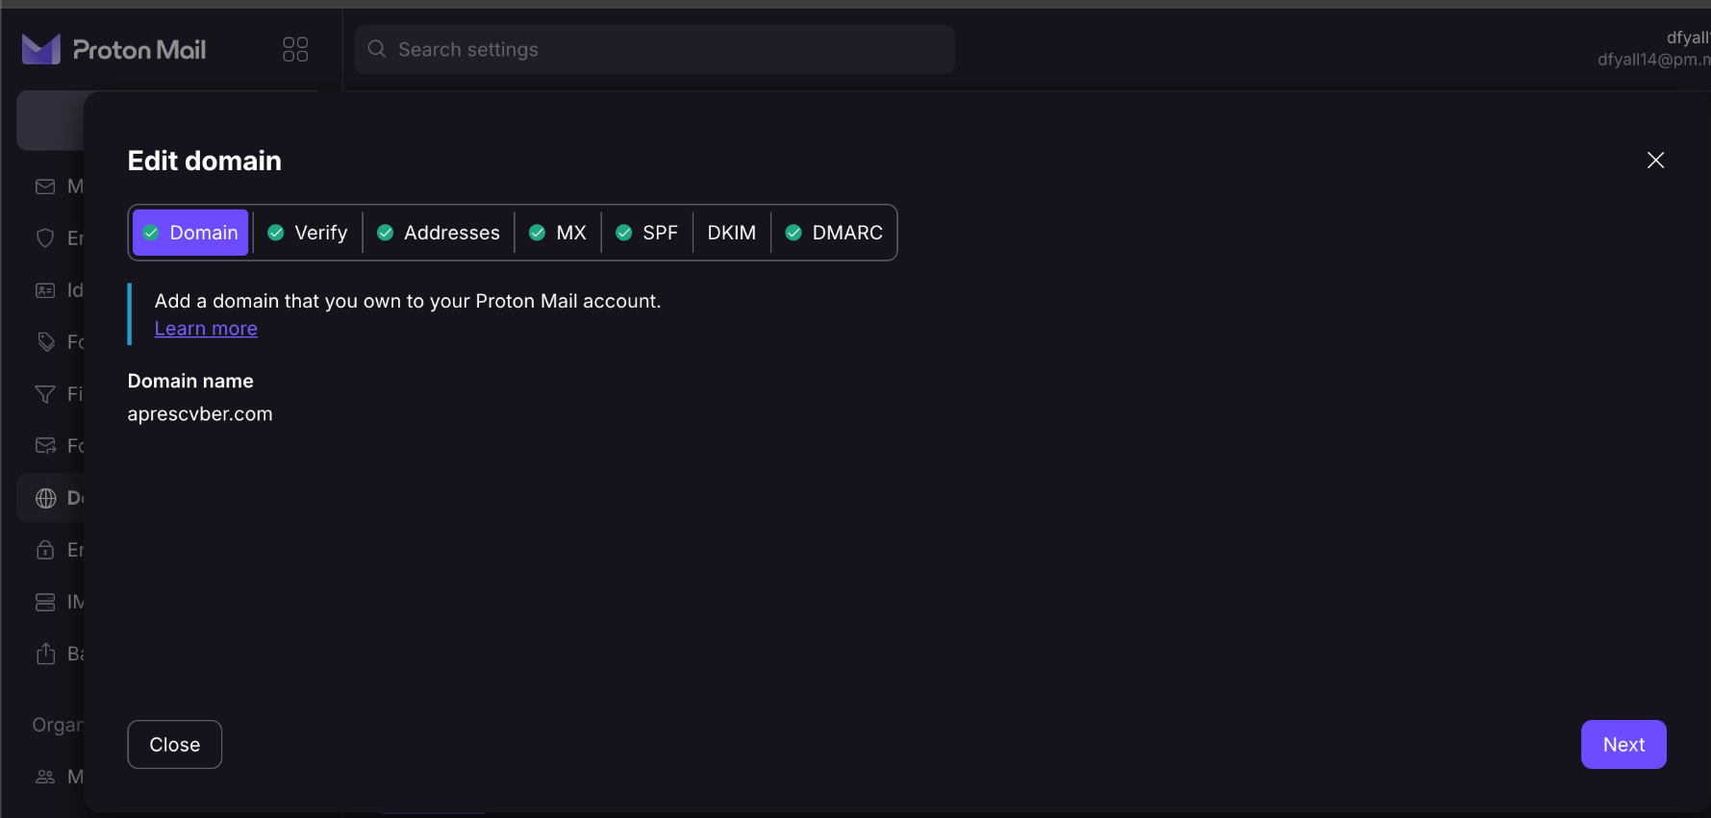
The Exploit (cont.)
The Payload/Exploit:
The payload is the registration page where the TA will submit their personal and financial data. While our campaign does not include any malware, most phishing attempts release malware when triggered which allows the attacker to gain access to the person's computer or network system.
The Plausible Domain:
We (the attackers) created aprescvber.com as the domain name and the email address is info@aprescvber.com. It looks similar to the actual conference URL which makes it looks like a legit site that can be trusted and it can help prevent the email from going to the spam folder. To decrease the possibility of the email going into the spam folder, we adjusted the MX, SPF, DKIM, and DMARC within the domain settings.

Slide 9
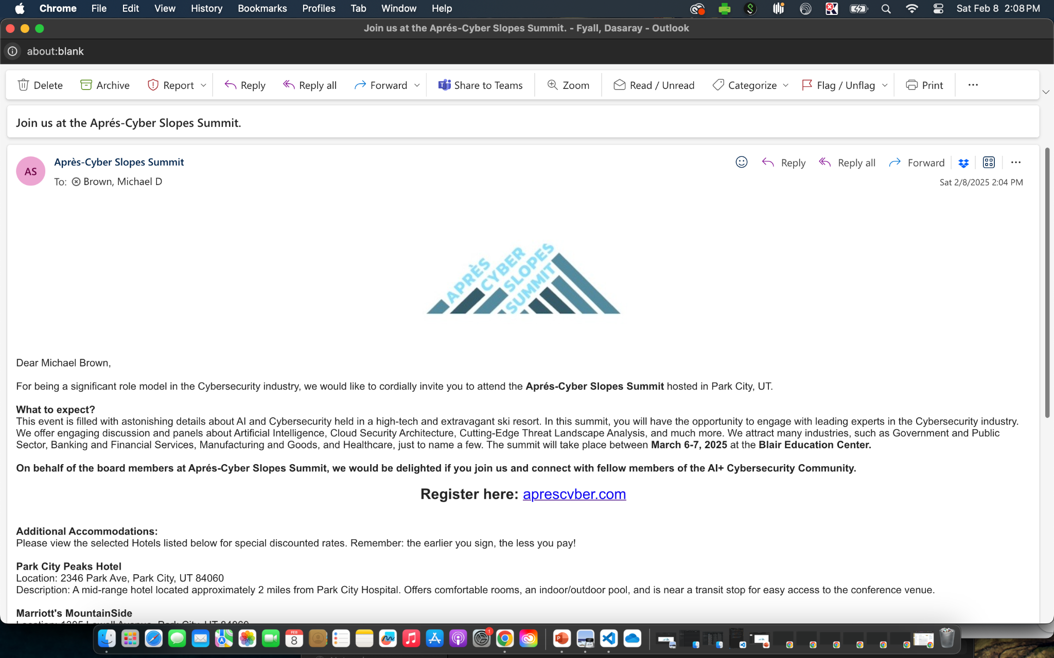
The Exploit (cont.)
The Phishing Email

Slide 10
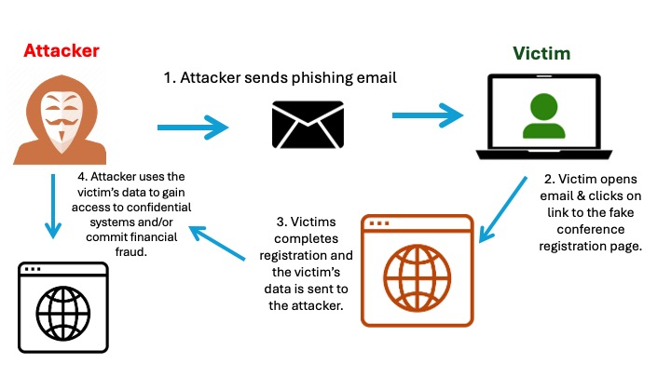
Phish Infrastructure

Slide 11
References
Apres-Cyber Slopes Summit. (n.d.). Apres-Cyber Slopes Summit. Retrieved January 20, 2025, from https://www.aprescyber.com/
Mailgun. (2024, January 29). Proven tips to stop emails from going to spam. Mailgun. https://www.mailgun.com/blog/deliverability/avoid-emails-going-to-spam/

Slide 12
Thank You!

